Slide 1
FUNDAMENTAL OF AC CIRCUITS
UNIT-II

Slide 2
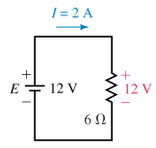
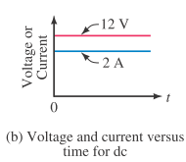
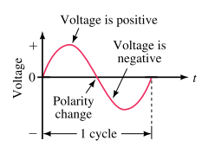
AC Fundamentals
Previously you learned that DC sources have ﬁxed polarities and constant magnitudes and thus produce currents with constant value and unchanging direction
In contrast, the voltages of ac sources alternate in polarity and vary in magnitude and thus produce currents that vary in magnitude and alternate in direction.

Slide 3
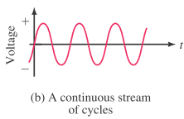

Sinusoidal ac Voltage
One complete variation is referred to as a cycle.
Starting at zero,
the voltage increases to a positive peak amplitude, decreases to zero,
changes polarity,
increases to a negative peak amplitude,
then returns again to zero.
Since the waveform repeats itself at regular intervals, it is called a periodic signal.
Symbol for an ac Voltage Source
Lowercase letter e is used
to indicate that the voltage varies with time.

Slide 4
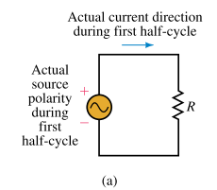
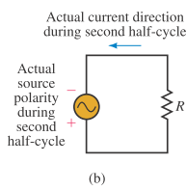
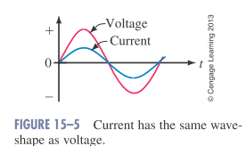
Sinusoidal ac Current
During the ﬁrst half-cycle, the source voltage is positive
Therefore, the current is in the clockwise direction.
During the second half-cycle, the voltage polarity reverses
Therefore, the current is in the counterclockwise direction.
Since current is proportional to voltage, its shape is also sinusoidal

Slide 5
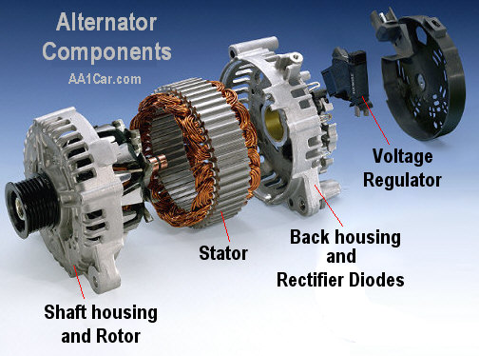
GENERATION OF AC VOLTAGE
An alternator is an electrical generator that converts mechanical energy to electrical energy in the form of alternating current
Principle: A conductor moving relative to a magnetic field develops an electromotive force (EMF) in it. (Faraday's Law).
This emf reverses its polarity when it moves under magnetic poles of opposite polarity.

Slide 6
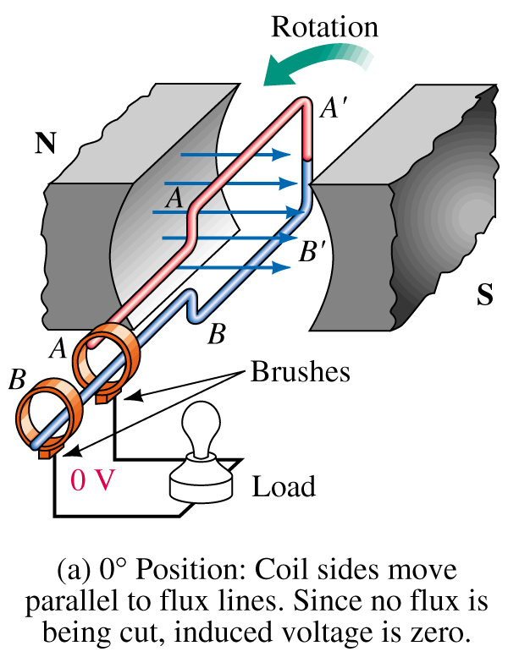
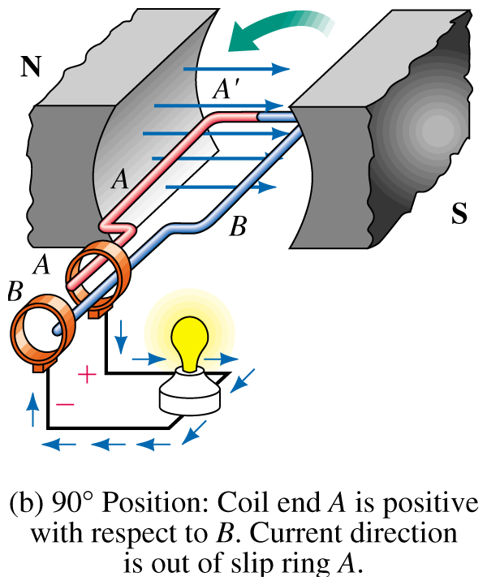
Generating AC Voltages

Slide 7
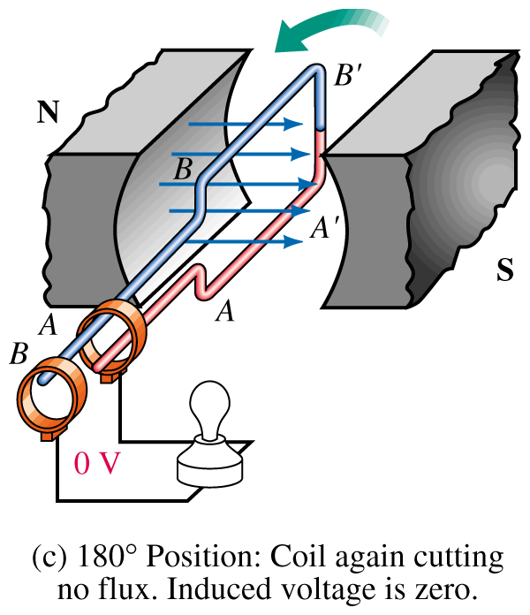
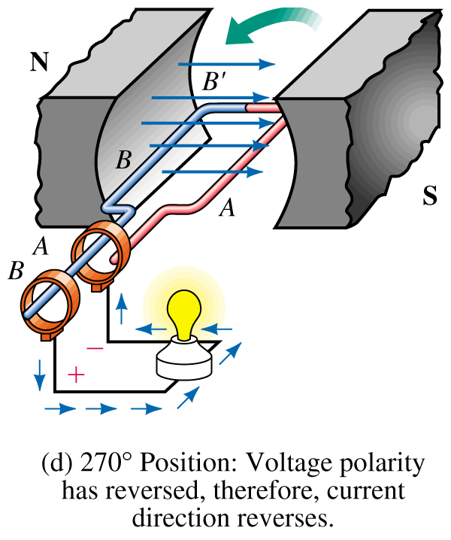
Generating AC Voltages

Slide 8
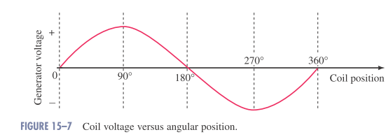
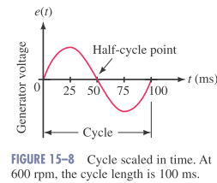
Generating ac Voltages
Since the coil rotates continuously, the voltage produced will be a repetitive,
Time Scales
Often we need to scale the output voltage in time.
The length of time required to generate one cycle depends on the velocity of rotation.
600 revolutions in 1 minute = 600 rev / 60 s
= 10 revolutions in 1 second.
The time for 1 revolution = one-tenth of a second
= 100 ms

Slide 9
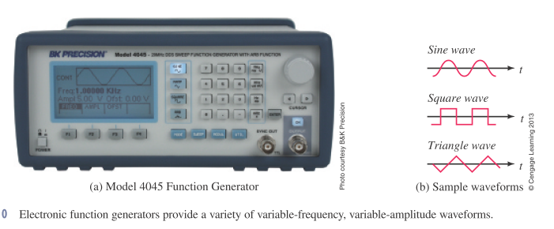
Generating ac Voltages (Method-2)
AC waveforms may also be created electronically using function (or signal) generators.
With function generators, you are not limited to sinusoidal ac. gear.
The unit of Figure can produce a variety of variable-frequency waveforms, including sinusoidal, square wave, triangular, and so on.
Waveforms such as these are commonly used to test electronic

Slide 10
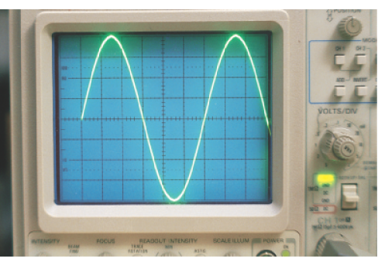
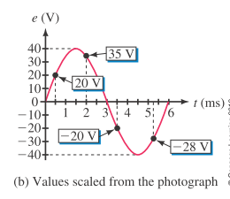
Instantaneous Value
As the coil voltage changes from instant to instant. The value of voltage at any point on the waveform is referred to as its instantaneous value.
The voltage has a peak value of 40 volts
The cycle time of 6 ms.
at t = 0 ms, the voltage is zero.
at t=0.5 ms, the voltage is 20V.

Slide 11
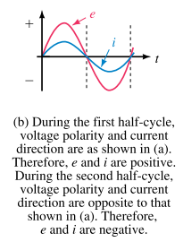
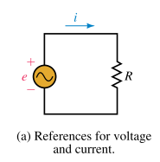
Voltage and Current Conventions for ac
First, we assign reference polarities for the source and a reference direction for the current.
We then use the convention that, when e has a positive value, its actual polarity is the same as the reference polarity, and when e has a negative value, its actual polarity is opposite to that of the reference.
For current, we use the convention that when i has a positive value, its actual direction is the same as the reference arrow,
and when i has a negative value, its actual direction is opposite to that of the reference.

Slide 12
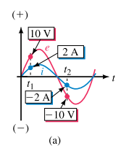
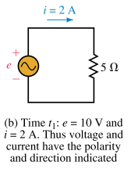
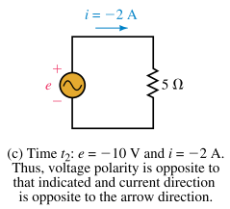
Voltage and Current Conventions for ac

Slide 13
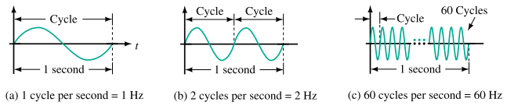

Attributes of Periodic Waveforms
Periodic waveforms (i.e., waveforms that repeat at regular intervals), regardless of their wave shape, may be described by a group of attributes such as:
Frequency, Period, Amplitude, Peak value.
Frequency:
The number of cycles per second of a waveform is defined
Frequency is denoted by the lower-case letter f.
In the SI system, its unit is the hertz (Hz, named in honor of pioneer researcher Heinrich Hertz, 1857–1894).

Slide 14
Attributes of Periodic Waveforms
Frequency Ranges:
The range of frequencies is huge.
Power line frequencies, for example, are 60 Hz in North America and 50 Hz in many other parts of the world.
Audible sound frequencies range from about 20 Hz to about 20 kHz.
The standard AM radio band occupies from 550 kHz to 1.6 MHz
The FM band extends from 88 MHz to 108 MHz.
TV transmissions occupy several bands in the 54-MHz to 890-MHz range.
Above 300 GHz are optical and X-ray frequencies.

Slide 15
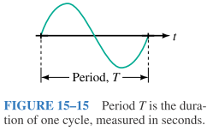

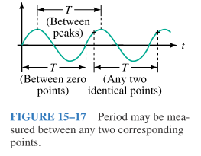
Attributes of Periodic Waveforms
Period:
The period, T, of a waveform, is the duration of one cycle.
It is the inverse of frequency.
The period of a waveform can be measured between any two corresponding points ( Often it is measured between zero points because they are easy to establish on an oscilloscope trace).

Slide 16
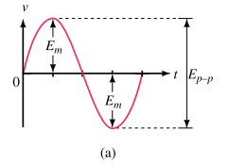
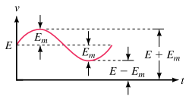
Attributes of Periodic Waveforms
Amplitude , Peak-Value, and Peak-to-Peak Value
Amplitude (Em):
The amplitude of a sine wave is the distance from its average to its peak.
Peak-to-Peak Value (Ep-p):
It is measured between minimum and maximum peaks.
Peak Value
The peak value of a voltage or current is its maximum value with respect to zero.
In this figure : Peak voltage = E + Em

Slide 17

The Basic Sine Wave Equation
The voltage produced by the previously described generator is:
Em: the maximum coil voltage and
α : the instantaneous angular position of the coil.
For a given generator and rotational velocity, Em is constant.)
Note that a 0° represents the horizontal position of the coil and that one complete cycle corresponds to 360°.

Slide 18
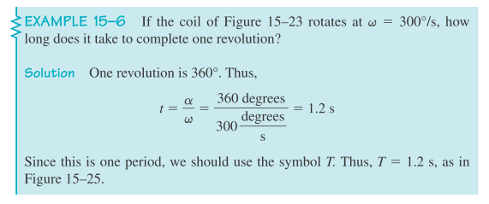
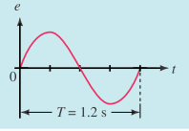
Angular Velocity (ω)
The rate at which the generator coil rotates is called its angular velocity
If the coil rotates through an angle of 30° in one second, its angular velocity is 30° per second.
When you know the angular velocity of a coil and the length of time that it has rotated, you can compute the angle through which it has turned using:

Slide 19
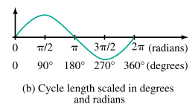

Radian Measure
In practice, q is usually expressed in radians per second,
Radians and degrees are related by :
For Conversion:

Slide 20



Relationship between ω, T, and f
Earlier you learned that one cycle of sine wave may be represented as either:
Substituting these into:
Sinusoidal Voltages and Currents as Functions of Time:
We could replace the angle α as:

Slide 21
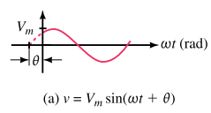
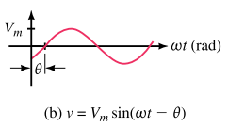
Voltages and Currents with Phase Shifts
If a sine wave does not pass through zero at t =0 s, it has a phase shift.
Waveforms may be shifted to the left or to the right

Slide 22
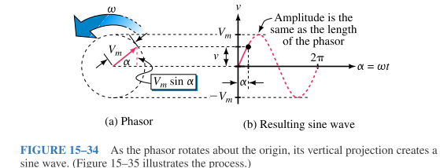
Introduction to Phasors
A phasor is a rotating line whose projection on a vertical axis can be used to represent sinusoidally varying quantities.
To get at the idea, consider the red line of length Vm shown in Figure :
The vertical projection of this line (indicated in dotted red) is :
v =
By assuming that the phasor rotates at angular velocity of ω rad/s in the counterclockwise direction

Slide 23
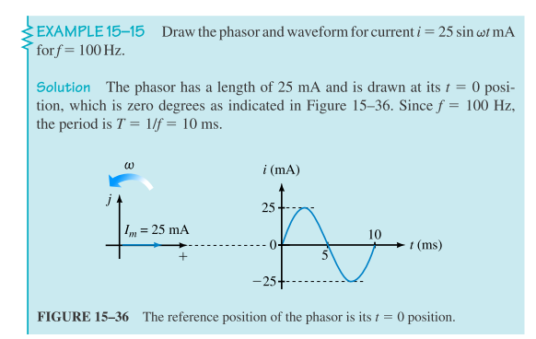
Introduction to Phasors

Slide 24
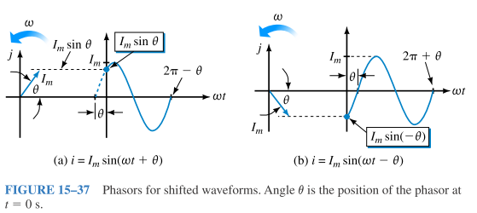
Shifted Sine Waves Phasor Representation

Slide 25
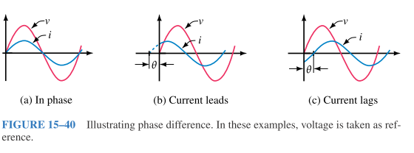
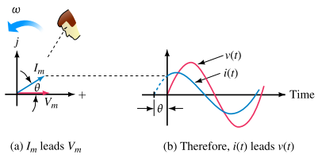
Phasor Difference
Phase difference refers to the angular displacement between different waveforms of the same frequency.
The terms lead and lag can be understood in terms of phasors. If you observe phasors rotating as in Figure, the one that you see passing first is leading and the other is lagging.

Slide 26

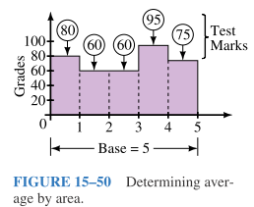

AC Waveforms and Average Value
Since ac quantities constantly change its value, we need one single numerical value that truly represents a waveform over its complete cycle.
Average Values:
To find the average of a set of marks for example, you add them, then divide by the number of items summed.
For waveforms, the process is conceptually the same. You can sum the instantaneous values over a full cycle, then divide by the number of points used.
The trouble with this approach is that waveforms do not consist of discrete values.
Average in Terms of the Area Under a Curve:
Or use area

Slide 27
AC Waveforms and Average Value
To find the average value of a waveform, divide the area under the waveform by the length of its base.
Areas above the axis are counted as positive, while areas below the axis are counted as negative.
This approach is valid regardless of waveshape.
Average values are also called dc values, because dc meters indicate average values rather than instantaneous values.

Slide 28
The Basic Sine Wave Equation
Voltage produced by a alternator is
e = E_{m} sin α
E_{m} is maximum (peak) voltage
α is instantaneous angular position of rotating coil of the generator

Slide 29
The Basic Sine Wave Equation
Voltage at angular position of sine wave generator
May be found by multiplying E_{m} times the sine of angle at that position

Slide 30
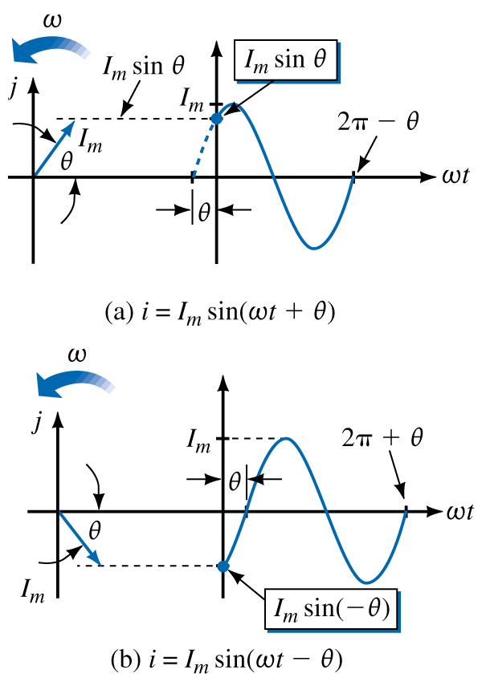
Shifted Sine Waves
Phasors used to represent shifted waveforms
Angle θ is position of phasor at t = 0 seconds

Slide 31
Phase Difference
Phase difference is angular displacement between waveforms of same frequency
If angular displacement is 0°
Waveforms are in phase

Slide 32
Phase Difference
If angular displacement is not 0º, they are out of phase by amount of displacement

Slide 33
Phase Difference
If v₁ = 5 sin(100t) and v₂ = 3 sin(100t - 30°), v₁ leads v₂ by 30°
May be determined by drawing two waves as phasors
Look to see which one is ahead of the other as they rotate in a counterclockwise direction

Slide 34
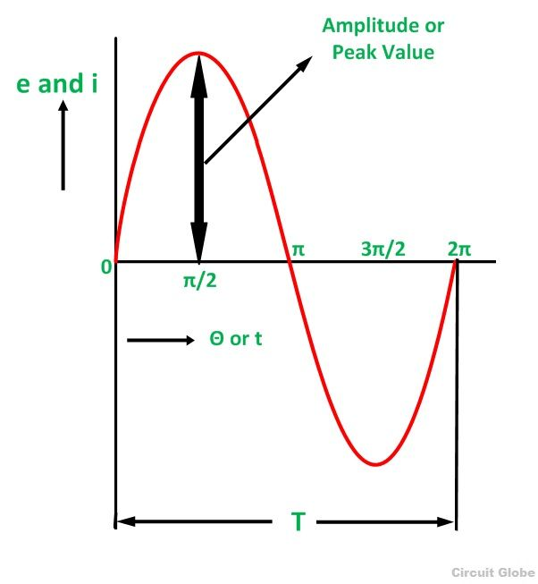
Peak Value
The maximum value attained by an alternating quantity during one cycle is called its Peak value. It is also known as the maximum value or amplitude or crest value.

Slide 35
Average Value
To find an average value of a waveform
Divide area under waveform by length of its base
Areas above axis are positive, areas below axis are negative.
The average of all the instantaneous values of an alternating voltage and currents over one complete cycle is called Average Value.

Slide 36
Average Value
Average values also called dc values
dc meters indicate average values rather than instantaneous values

Slide 37
Sine Wave Averages
Average value of a sine wave over a complete cycle is zero
Average over a half cycle is not zero

Slide 38
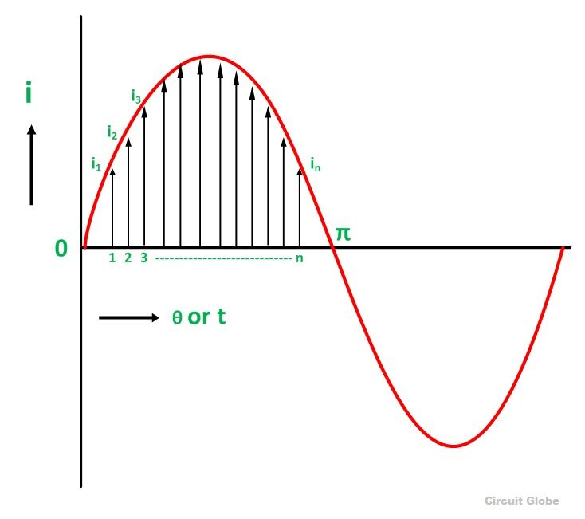
Average Value

Slide 39

Average Value
Divide the positive half cycle into (n) number of equal parts as shown in the above figure
Let i₁, i₂, i₃…….. i_{n} be the mid ordinates
The Average value of current I_{av} = mean of the mid ordinates

Slide 40
Sine Wave Averages
Rectified full-wave average is 0.637 times the maximum value
Rectified half-wave average is 0.318 times the maximum value

Slide 41
Effective Values or RMS Value
Effective value or RMS value of an ac waveform is an equivalent dc value
It tells how many volts or amps of dc that an ac waveform supplies in terms of its ability to produce the same average power

Slide 42
R.M.S Value
Definition: That steady current which, when flows through a resistor of known resistance for a given period of time than as a result the same quantity of heat is produced by the alternating current when flows through the same resistor for the same period of time is called R.M.S or effective value of the alternating current.

Slide 43
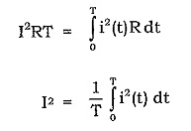
RMS value derivation

Slide 44
Effective Values or RMS Value
To determine effective power
Set Power(dc) = Power(ac)
P_{dc} = p_{ac}
I²R = i²R where i = I_{m} sin ωt
By applying a trigonometric identity
Able to solve for I in terms of I_{m}

Slide 45
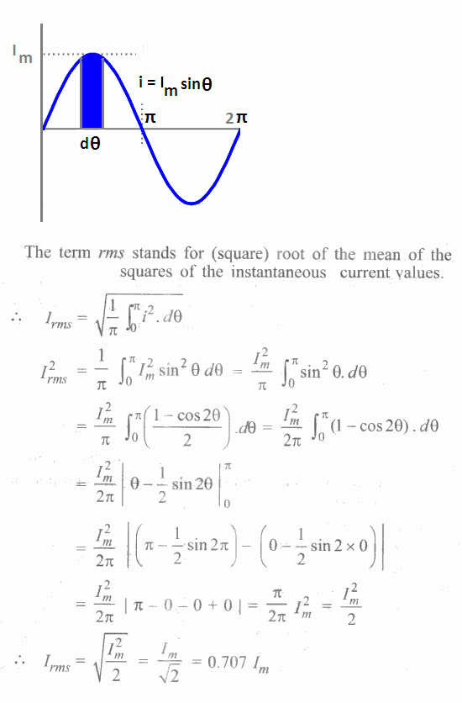

Slide 46
Effective Values
I_{eff} = .707I_{m}
V_{eff} = .707V_{m}
Effective value is also known as the RMS value

Slide 47
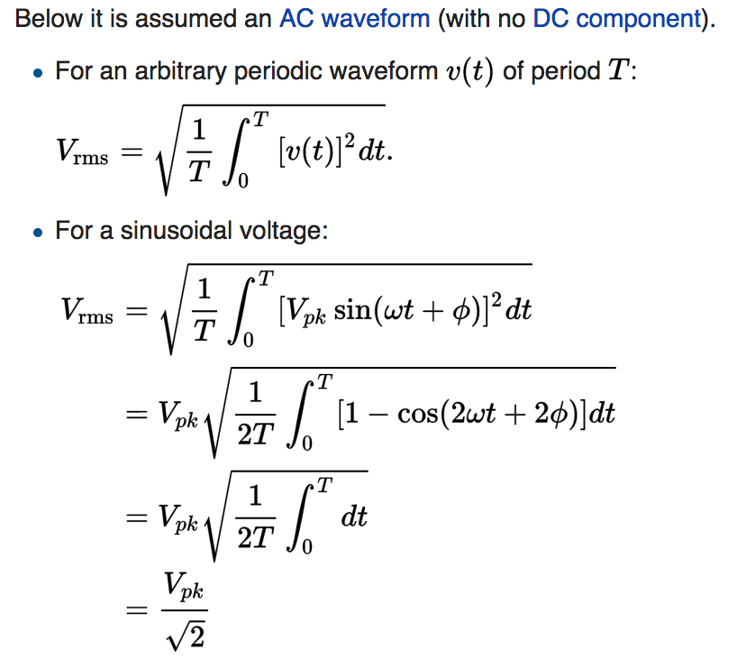
RMS value or Effective value

Slide 48
Voltage | 6.2V | 11.8V | 16.2V | 19.0V | 20.0V | 19.0V | 16.2V | 11.8V | 6.2V | 0V
Angle | 18º | 36º | 54º | 72º | 90º | 108º | 126º | 144º | 162º | 180º

Slide 49
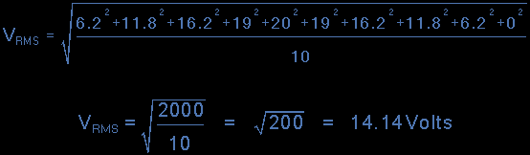

Slide 50
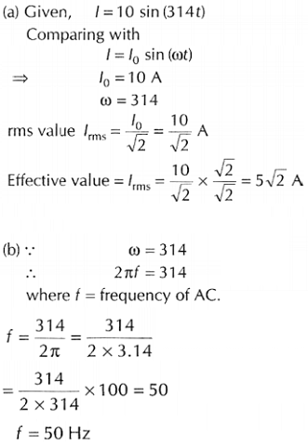
Problem on frequency and rms value

